Slide 1

Data Structures And Algorithms Self-Paced
CSE 343 –TRAINING IN PROGRAMMING

Slide 2
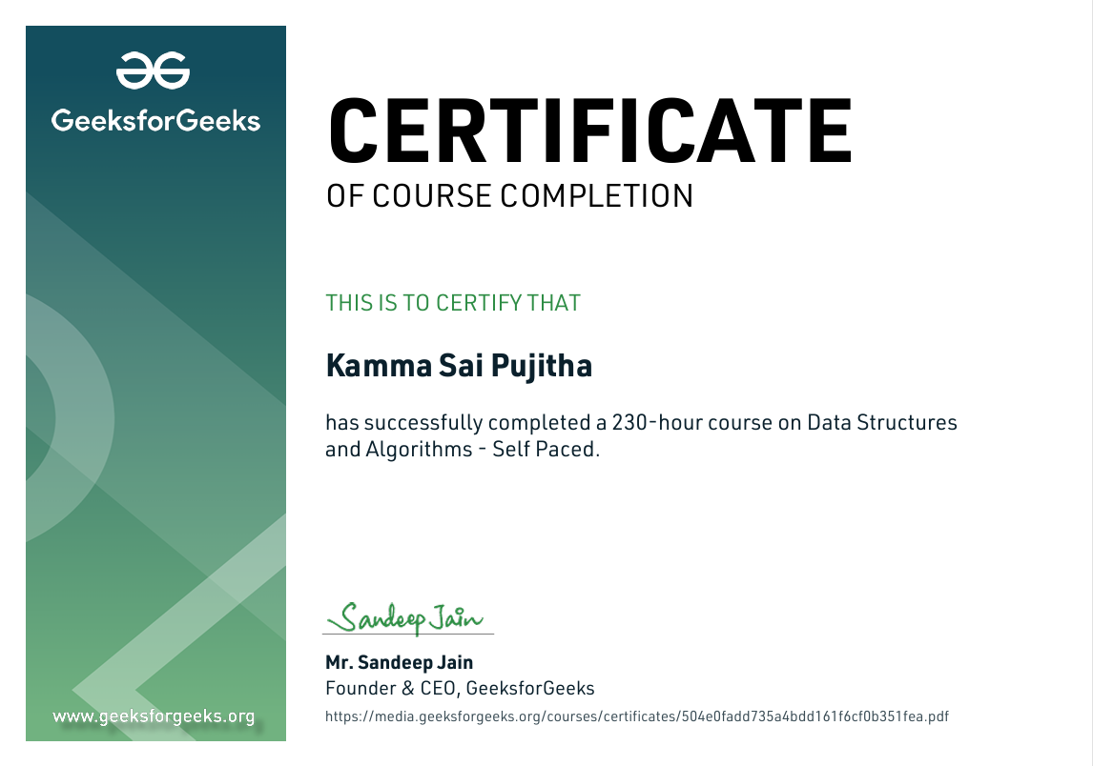
Certificate of Completion

Slide 3
Outlines
Acquire Basic Programming Skills Using Data Structures
Work with a Variety of Data Structures
Solve basic Competitive coding problems using Data Structures
Apply Data Structures and Algorithmic Concepts in developing Useful projects

Slide 4
Data Structures
Definition:
A data structure is a storage that is used to store and organize data. It is a way of arranging data on a computer so that it can be accessed and updated efficiently.

Slide 5
Asymptotic Notations
Why to use these? Asymptotic notations (like Big O, Big Omega, and Big Theta) are used in computer science to describe the behavior of algorithms in terms of their efficiency and how they scale with input size.
It helps us to compare the runtimes of different algorithms without actually calculating their runtimes manually.
Big O Notation is Used to describe Worst-case Analysis
Big Omega Notation is Used to describe Best-case running time.
Big Theta Notation is used for comparisons of running Times
Special Classes of Algorithms:
Logarithmic: O(log n)
Linear: O(n)
Quadratic: O(n²)
Polynomial: O(n^{k}), k >= 1
Exponential: O(a^{n}), a > 1

Slide 6
Array
Definition : An array is a collection of items of same data type stored at contiguous memory locations.
1.Insertion
3.Searching
Linear Search | Binary Search
4. Sorting Algorithms (Bubble Sort, Insertion Sort, Selection Sort, Merge Sort, Quick Sort)
2.Deletion

Slide 7
Linked List
Definition : A linked list is a linear data structure, in which the elements are not stored at contiguous memory locations.
1.Doubly Linked List
2.Circular Linked List
Insertion
Deletion

Slide 8
Stack
Definition : Stack is a linear data structure that follows a particular order in which the operations are performed. The order may be LIFO(Last In First Out) or FILO(First In Last Out). LIFO implies that the element that is inserted last, comes out first and FILO implies that the element that is inserted first, comes out last.
Operations of Stack :
Deletion or (Pop Operation)
Top or (Peek Operation)
Insertion or (Push Operation)

Slide 9
Queue
Definition : A Queue is defined as a linear data structure that is open at both ends and the operations are performed in First In First Out (FIFO) order.
Operations :
Insertion | Enque Operation
Deletion | Deque Operation
Front and Rear
Doubly Ended Queue and Priority Queues

Slide 10
Tree
Definition :Non-Linear Data Structures where each node is connected to several nodes with the help of Pointers or reference
Binary Tree : nodes having at most 2 children
Operations :
Preorder of a Tree
Inorder of a tree
Postorder of a tree

Slide 11
Heaps
Definition :It is a Tree-based data structure which follows the below properties
1.Heap is a complete tree (All levels are filled except possibly the last level and the last level has all keys as left as possible
2.Heap is either Min Heap or Max Heap .In Min Heap ,the key at the root must be minimum among all keys present in the tree

Slide 12
Graph
A Graph is a non-linear data structure consisting of vertices and edges. The graph is denoted by G(E, V).
Undirected Graphs: A graph in which edges have no direction, i.e., the edges do not have arrows indicating the direction of traversal. Example: A social network graph where friendships are not directional.
Directed Graphs: A graph in which edges have a direction, i.e., the edges have arrows indicating the direction of traversal. Example: A web page graph where links between pages are directional.

Slide 13
PROJECT
Title :
Algorithm Simulator
Functionalities :
Sorting any given input in Ascending/Descending order and displaying all iterations of the chosen algorithm
Data Structure Used:
Arrays

Slide 14
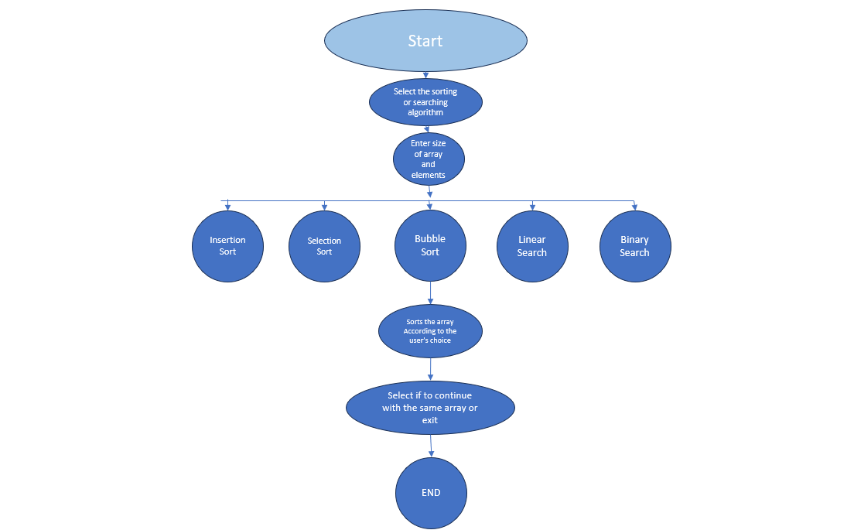
Project Flow Chart

Slide 15
Thank You…..

